Slide 1


EOMP #3 PRESENTATION
Team: Imagineers
Customer: mrs.thao to
MENTOR: Mr.Hieu To

Slide 2

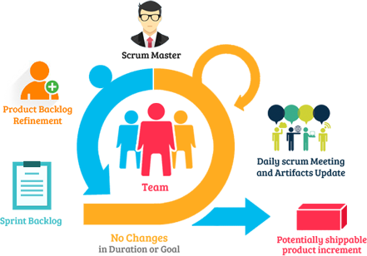

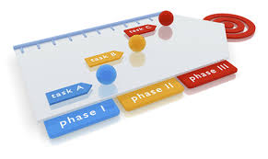
Objectives of the EOMP #3 Presentation
Notes:
Team formation
Development process establishing
Strategic and tactical project plan
Define basic assessment for risk management and product/system feasibility

Slide 3
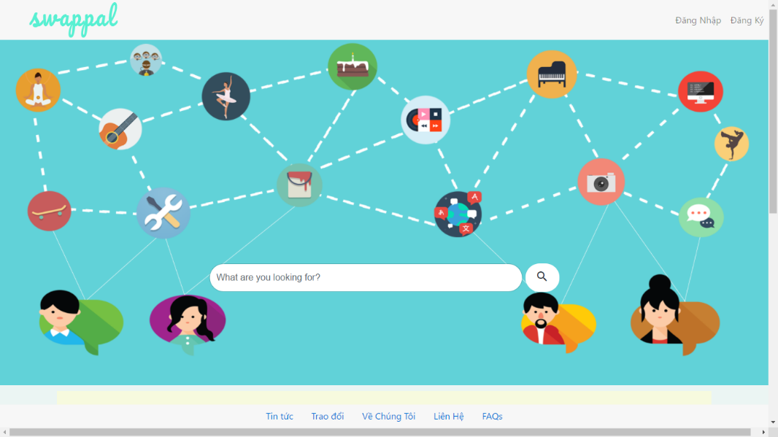

Objectives of the EOMP #3 Presentation
Notes:
Team formation
Development process establishing
Strategic and tactical project plan
Define basic assessment for risk management and product/system feasibility

Slide 4





Content
Project overview
Development process
Project Planning
Process Decision
Team formation
Project execution

Slide 5

Content
Reflection
Product demo

Slide 6
Project Overview
Part 1: Business background

Slide 7

Business background
Sharing & Learning
Without paying fee
Making relationship
Building trust
SHARING COMMUNITY
Notes:
Background: Nowadays, lots of people share and get information from each other.
We build community based on sharing new things( skills, services, goods) across the world

Slide 8
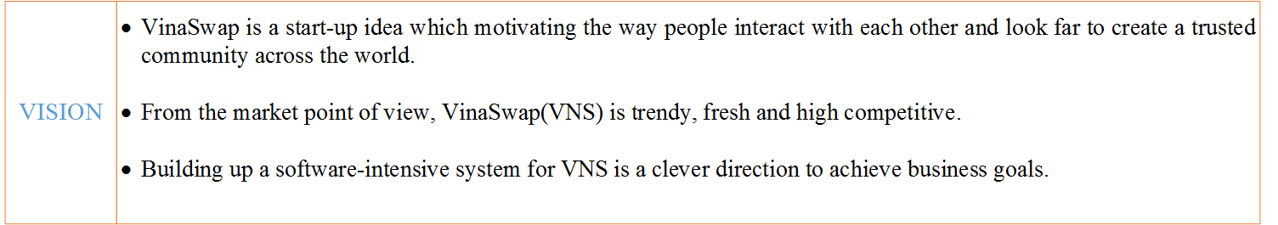
Product Vision
Notes:
VinaSwap’s SWOT
S(STRENGTHS)
- A surprise factor
- VINASWAP can be ahead in the business
- Free service for people
W(WEAKNESS)
- The business process vague
- It can be challenge to change user’s mind
- Lack of experiences
O(OPPORTUNITIES)
- Other business to marketing theirs
- Business opportunities are big
- VINASWAP could be the biggest Swap and Bartering site in Vietnam
- It can turn into a great social place
- Can build trust relationship and friendship
T(THREATs).
-Can be a threat due to trusting issues.
- Competitors like Cragslist...
- The cost to run the site and app can be a challenge

Slide 9
Project Overview
Part 1: Project Stakeholders

Slide 10
Project Stakeholders-Customer
CUSTOMER: MS. THAO TO | INFORMATION
FULL NAME | TO THI THU THAO
D.O.B | 18/06/1985
JOB | Freelance English tutor
ROLE IN PROJECT | CUSTOMER
CELLPHONE | 0909144022
EMAIL ADDRESS | yenthaoxhnv@gmail.com
SKYPE | Sunflower_vn1
HOBBIES | Traveling, hiking, and meeting new people
Notes:
VinaSwap’s SWOT
S(STRENGTHS)
- A surprise factor
- VINASWAP can be ahead in the business
- Free service for people
W(WEAKNESS)
- The business process vague
- It can be challenge to change user’s mind
- Lack of experiences
O(OPPORTUNITIES)
- Other business to marketing theirs
- Business opportunities are big
- VINASWAP could be the biggest Swap and Bartering site in Vietnam
- It can turn into a great social place
- Can build trust relationship and friendship
T(THREATs).
-Can be a threat due to trusting issues.
- Competitors like Cragslist...
- The cost to run the site and app can be a challenge

Slide 11
Project Stakeholders-Mentor
MENTOR: MR. HIEU TO | INFORMATION
FULL NAME | TO DINH HIEU
JOB | CMU Lecturer
ROLE IN PROJECT | Mentor
EMAIL ADDRESS | todinhhieu@vanlanguni.edu.vn
Notes:
VinaSwap’s SWOT
S(STRENGTHS)
- A surprise factor
- VINASWAP can be ahead in the business
- Free service for people
W(WEAKNESS)
- The business process vague
- It can be challenge to change user’s mind
- Lack of experiences
O(OPPORTUNITIES)
- Other business to marketing theirs
- Business opportunities are big
- VINASWAP could be the biggest Swap and Bartering site in Vietnam
- It can turn into a great social place
- Can build trust relationship and friendship
T(THREATs).
-Can be a threat due to trusting issues.
- Competitors like Cragslist...
- The cost to run the site and app can be a challenge

Slide 12
Project Stakeholders-Development Team
TEAM: IMAGINEERS | INFORMATION
FULL NAME | IMAGINEERS
ROLE IN PROJECT | Development Team
EMAIL ADDRESS (of prepesentative) | b.thach511@gmail.com
Notes:
VinaSwap’s SWOT
S(STRENGTHS)
- A surprise factor
- VINASWAP can be ahead in the business
- Free service for people
W(WEAKNESS)
- The business process vague
- It can be challenge to change user’s mind
- Lack of experiences
O(OPPORTUNITIES)
- Other business to marketing theirs
- Business opportunities are big
- VINASWAP could be the biggest Swap and Bartering site in Vietnam
- It can turn into a great social place
- Can build trust relationship and friendship
T(THREATs).
-Can be a threat due to trusting issues.
- Competitors like Cragslist...
- The cost to run the site and app can be a challenge

Slide 13
Product / System feasibility
Part 1: SWOT

Slide 14

Product / System feasibility - SWOT
Strengths
Weakness
Oppotunities
Threats
Notes:
VinaSwap’s SWOT
S(STRENGTHS)
- A surprise factor
- VINASWAP can be ahead in the business
- Free service for people
W(WEAKNESS)
- The business process vague
- It can be challenge to change user’s mind
- Lack of experiences
O(OPPORTUNITIES)
- Other business to marketing theirs
- Business opportunities are big
- VINASWAP could be the biggest Swap and Bartering site in Vietnam
- It can turn into a great social place
- Can build trust relationship and friendship
T(THREATs).
-Can be a threat due to trusting issues.
- Competitors like Cragslist...
- The cost to run the site and app can be a challenge

Slide 15
Product / System feasibility
Part 2: Business Model

Slide 16

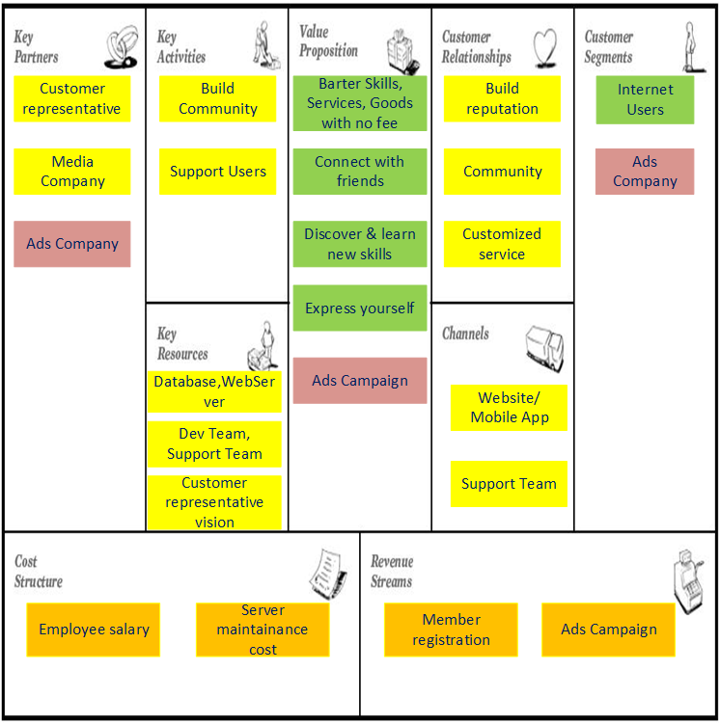
Product / System feasibility - Business model
Notes:
business model canvas

Slide 17
Project Overview
Part 2: Project description

Slide 18
Project description
Build a community site to help Vinaswap members swap and barter skills directly without paying any fees
Duration: 30 weeks
Expected Start date: 3/10/2016 –End: 29/05/2017
The system is developed in Web-based application
Notes:
Background: Nowadays, lots of people share and get information from each other.
We build community based on sharing new things across the world
Our customer: Mrs Thao wants to start up a community site to help users (Vinaswap members) swap and barter skills directly and without paying any fees.

Slide 19
Team Formation
Part 1: Team introduction

Slide 20

Team Formation - Team Name & Logo
IMAGINATIVE
ENGINEERS
Notes:
Background: Nowadays, lots of people share and get information from each other.
We build community based on sharing new things across the world

Slide 21
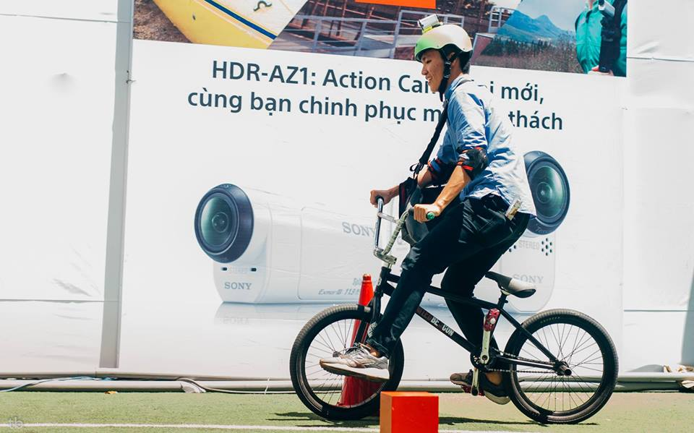
Team Formation - Team Members
FULL NAME: NGUYEN BAO THACH
PHONE: 0906. 729 567
EMAIL: b.thach511@gmail.com
SKYPE: b.thach511@gmail.com
Scrum master
Leader
Thach Nguyen
Notes:
Background: Nowadays, lots of people share and get information from each other.
We build community based on sharing new things across the world

Slide 22
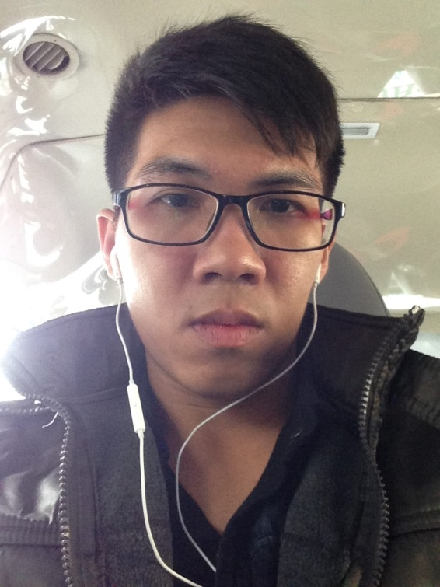
Team Formation - Team Members
FULL NAME: NGUYEN HUU TAI
PHONE: 0125. 434 5446
EMAIL: nguyenhuutai1995k19t01@gmail.com
SKYPE: huutai1995
Scrum Team Member
Tai Nguyen
Notes:
Background: Nowadays, lots of people share and get information from each other.
We build community based on sharing new things across the world

Slide 23
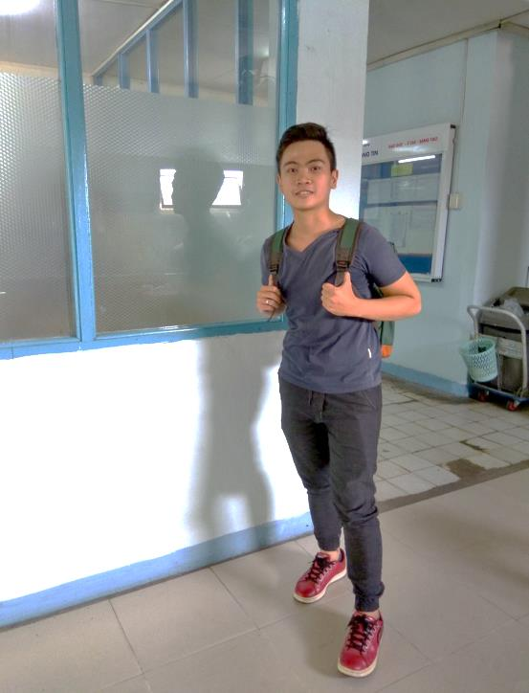
Team Formation - Team Members
FULL NAME: DANG QUOC VIET
PHONE: 0937. 461 963
EMAIL: vietdang.2509@gmail.com
SKYPE: viet.2509
Scrum Team Member
Viet Dang
Notes:
Background: Nowadays, lots of people share and get information from each other.
We build community based on sharing new things across the world

Slide 24
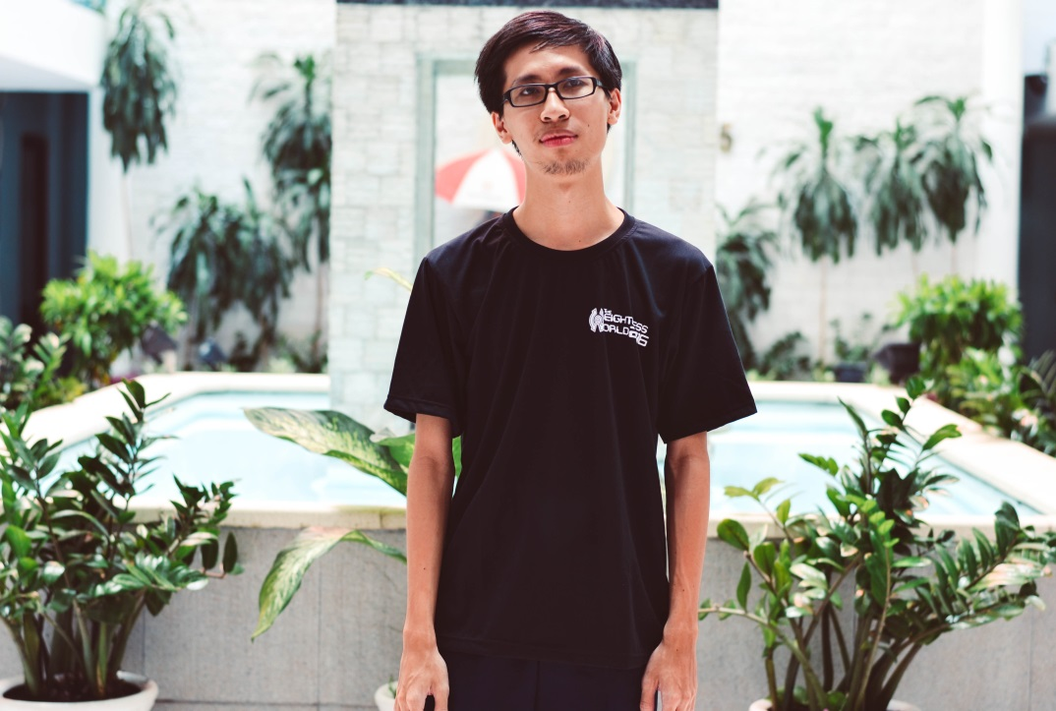
Team Formation - Team Members
FULL NAME: TRAN PHAN TRUNG CHANH
PHONE: 0122. 703 4475
EMAIL: hunteratthenight@gmail.com
SKYPE: zodiark1412
Scrum Team Member
Chanh Tran
Notes:
Background: Nowadays, lots of people share and get information from each other.
We build community based on sharing new things across the world

Slide 25

Team Formation - Team Members
FULL NAME: NGUYEN HOANG NAM PHUONG
PHONE: 0128. 573 93 98
EMAIL: nguyenhoangnamphuong2110@gmail.com
SKYPE: nam_phuong1994
Product owner
Phuong Nguyen
Notes:
Background: Nowadays, lots of people share and get information from each other.
We build community based on sharing new things across the world

Slide 26
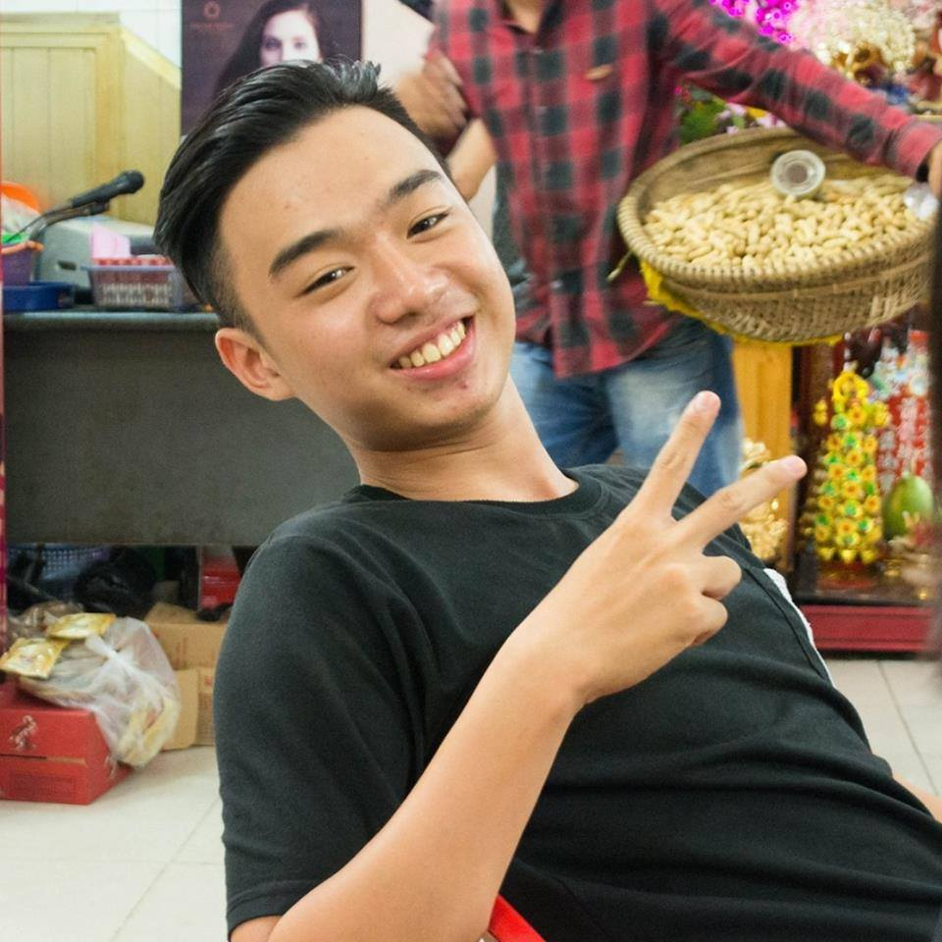
Team Formation - Team Members
FULL NAME: NGUYEN DANG QUANG
PHONE: 090. 305 4493
EMAIL: ndq.quang511@gmail.com
SKYPE: quang_nguyen73
Scrum Team Member
Quang Nguyen
Notes:
Background: Nowadays, lots of people share and get information from each other.
We build community based on sharing new things across the world

Slide 27
Team Formation
Part 2: Purpose, Team Goals & Working Policy

Slide 28
Team Formation - Main Purposes
Deliver high quality product to customer by the end of project
Build up customer retention with team for future project
Notes:
S.M.A.R.T GOALS:

Slide 29
Team Formation - Team Goals
Meet 80% of customer satisfaction (see more in Imagineers-MeasurementPlan)
Get 70% of positive feedbacks from product increment review
Ship product increment on time (no late than 10% of time-box)
Notes:
S.M.A.R.T GOALS:

Slide 30




Team Formation - Team Policy
Notes:
Team Policy
Commitment
Communication
Reward
Succeed
Team Communication

Slide 31
Team Formation - Team Working Time
COMMITMENT | WORKWEEK | PLACE | DURATION
ALL members have to work for 30hrs/week 8 hours/ day Mon→Sat Sunday is day-off | Mon → Sat: daily Scrum meeting | Floor 7th | 15 mins
 | Monday: Mentor meeting | Room 701C | 1-1.5 hrs Start 13h30PM
 | Sat: Sprint review Sprint retrospective | Room 701C | 1-1.5 hrs Start 13h30PM
 | Tuesday: Team meeting | Room 701C | 1-1.5 hrs Start 13h30PM
Notes:
More information in team communication

Slide 32
Development process
Part 1: Process decision

Slide 33
Development process - Decision

Slide 34
Development process
Part 1: Defined Scrum framework

Slide 35
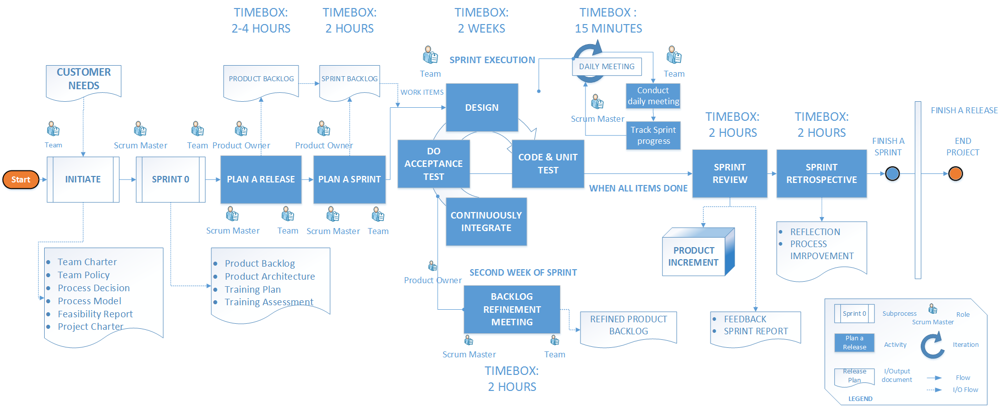
SCRUM PROCESS

Slide 36
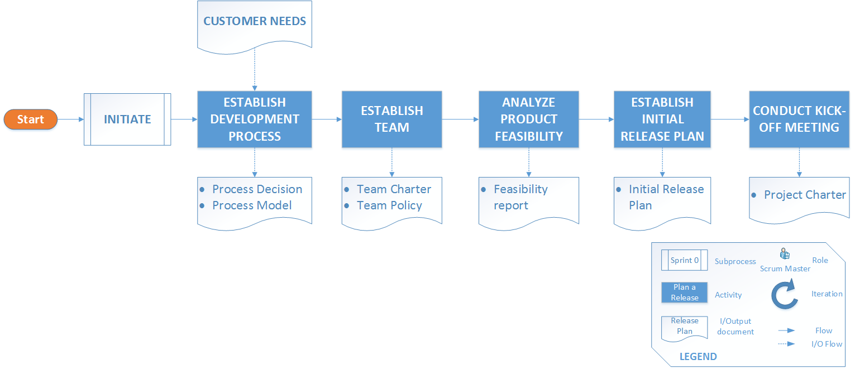
INITIATE SUB PROCESS

Slide 37
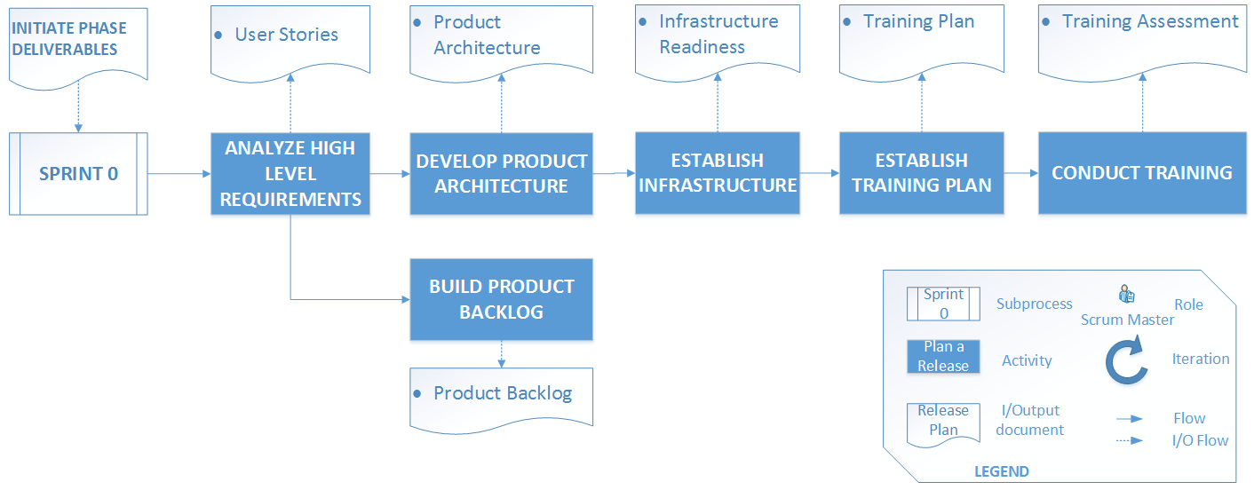
SPRINT 0 SUB PROCESS

Slide 38
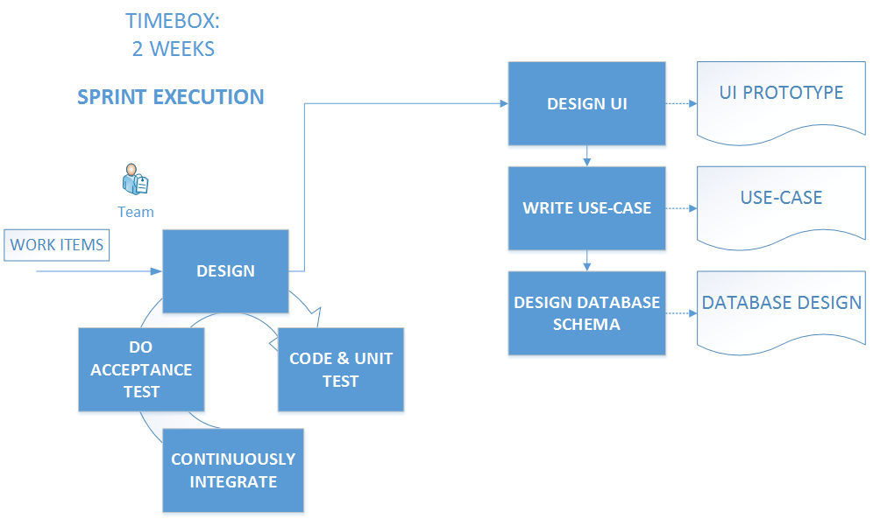
SCRUM EXECUTION

Slide 39
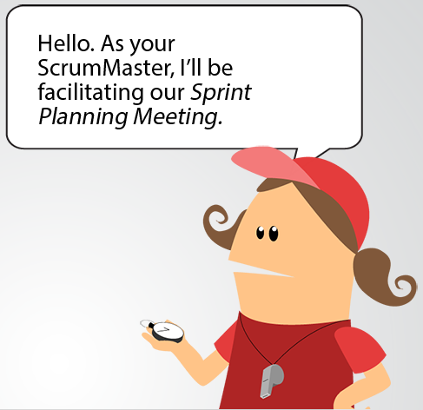
Development process - Roles & Responsibilities
Facilitating Scrum events.
Finding techniques for effective Product Backlog management.
Coaching the Development Team in self-organization and cross-functionality.
Removing impediments to the Development Team’s progress.
Notes:
Product owner
Scrum Master
Dev team

Slide 40
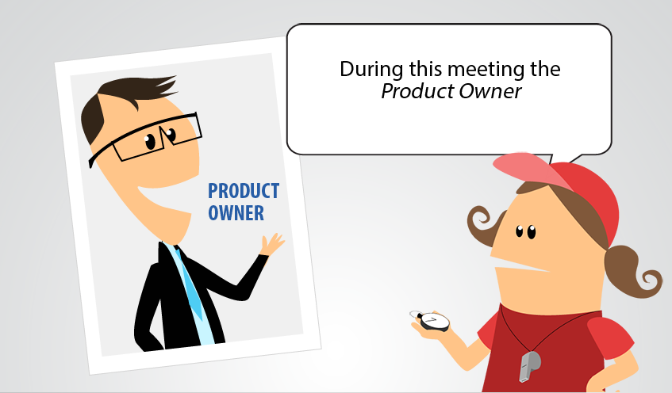
Development process - Roles & Responsibilities
Describe, Prioritize and Optimize the Product Backlog items.
Ensuring the Product Backlog is visible, transparent, and clear to all, and shows what the Scrum Team will work on next.
Ensuring Development Team understands items in the Product Backlog to the level needed.
Notes:
The Product Owner is the sole person responsible for managing the Product Backlog. Product Backlog management includes:
_Describe, Prioritize and Optimizing the Product Backlog items;
_Ensuring that the Product Backlog is visible, transparent, and clear to all, and shows what the Scrum Team will work on next,
_Ensuring Development Team understands items in the Product Backlog to the level needed.
Who want to change the Product Backlog item priority & description must address the PO.
No one is allowed to tell the Development Team to work from a different set of requirements, and the Development Team isn’t allowed to act on what anyone else says.

Slide 41
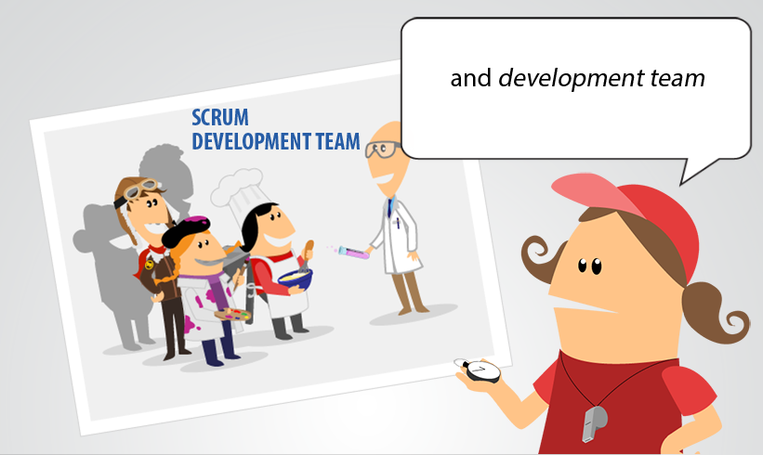
Development process - Roles & Responsibilities
Team of professionals.
Structured and Empowered
Self-organizing.
Cross-functional.
Notes:
Product owner
Scrum Master
Dev team

Slide 42
Project Planning
Part 1: Milestone

Slide 43
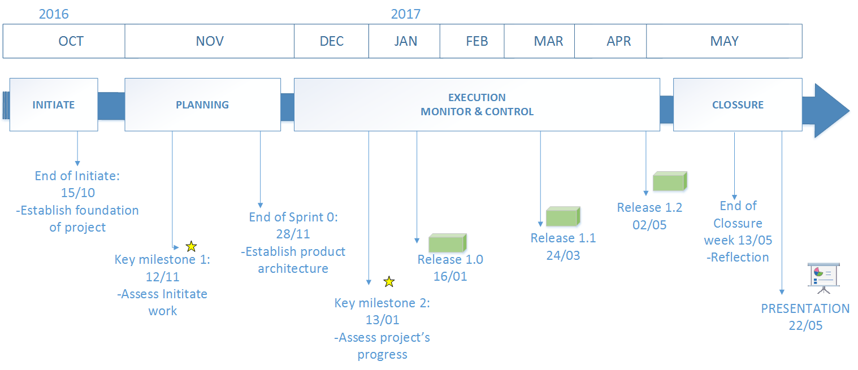
Project Planning- Milestone (old)
Status date
Notes:
Milestone

Slide 44
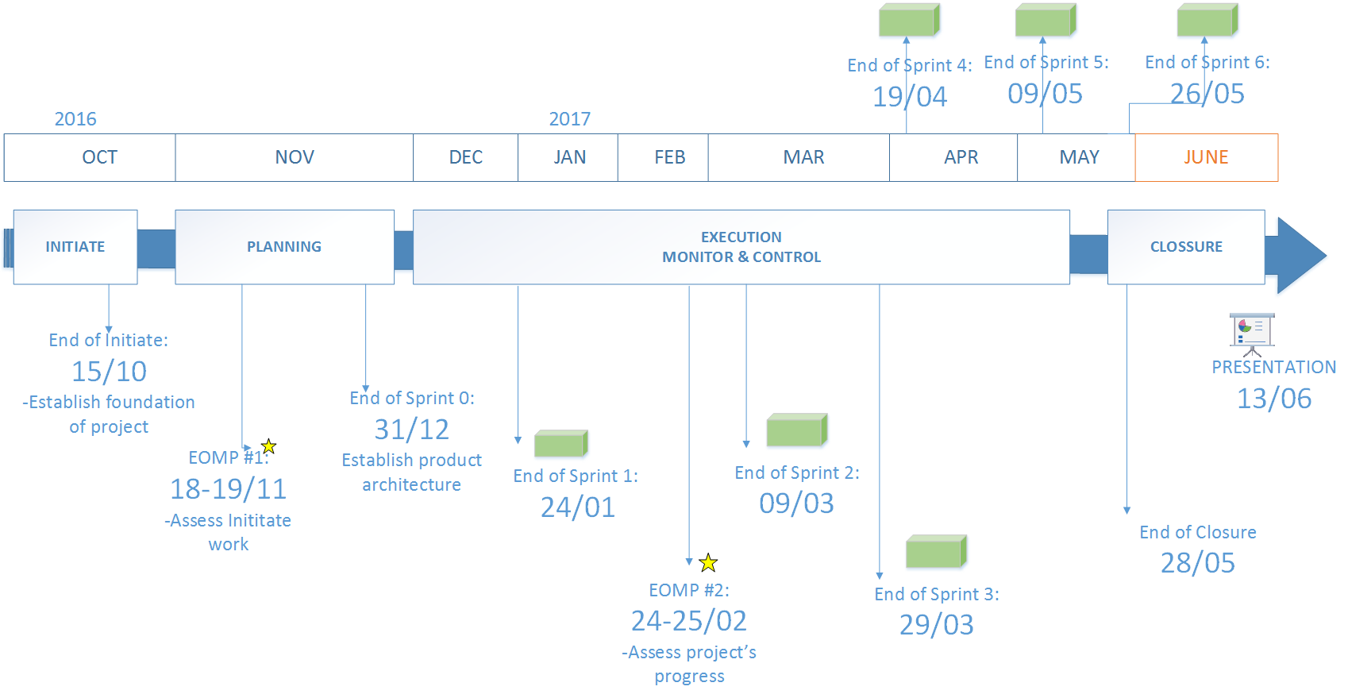
Project Planning- Milestone (updated)
Status date
Notes:
Milestone

Slide 45
Project Planning
Part 2: High-level Planning

Slide 46
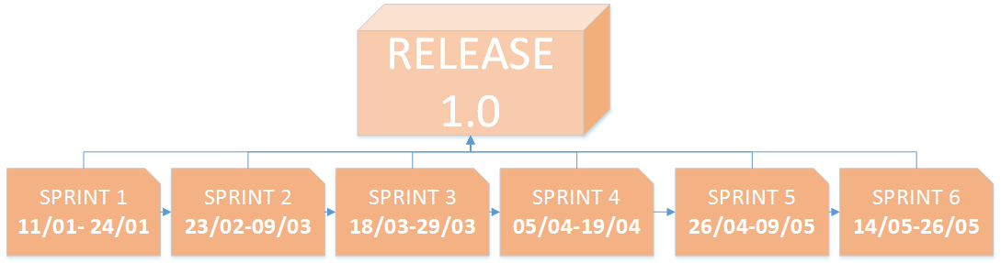
Project Planning- High level Planning (updated)

Slide 47
Product development stage
Part 1.0: Context/High level requirement

Slide 48
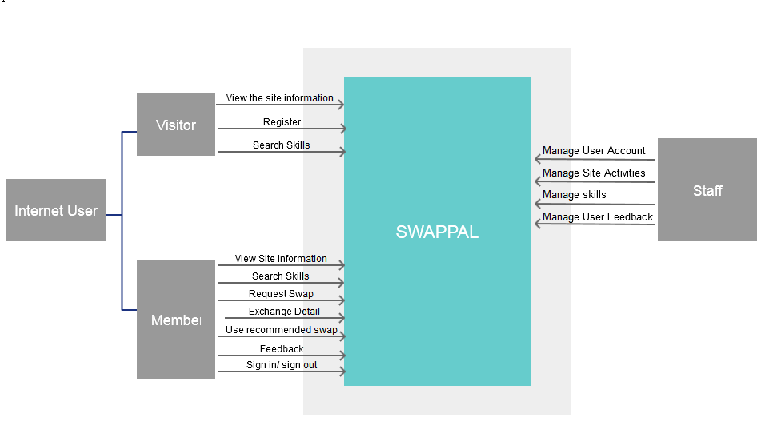
Context/High level Requirement-Scope

Slide 49
Product development stage
Part 2.0: Architecture drivers

Slide 50
Architecture drivers
6 Quality Attributes
31 Funtional Requirements
4 Constraints
1 Business/ 3 Technical

Slide 51
Product development stage
Part 2.1: Architecture rationale & decision

Slide 52
Architecture rationale
ID | Name | Concern | Description
 | Usability | User friendly GUI | Easy for different type of users to use the site Responsiveness
 | Performance | Response time | Load page from 3-5s Return html page to user from 3-5s
 |  | User throughput | Handle multiple user use site at a time(2000 per time)
 | Availability | Server uptime | Uptime 99,9%
 | Security | User information: account encrypted | Encrypted user account from hacker
 | Scalability | Scale out | Server growth in future
 | Testability | Can perform testing | Unit testing Load testing Performance testing

Slide 53
Architecture decision
ID | Name | Description
 | Using web app Satisfy -TC3-Accessible from browser -Feature: Staff manage Account, View report site activities -QA: Testing | Cost effective: Access system via web browser. Test on 1 operating system can fulfill the rest Accessible anywhere: via Internet connection(require) Easily customizable: user interfaces of web application is easier to customize than the desktop application( Related to concern Look and feel of GUI) Accessbile for a range of devices: inc. mobile phones, PCs.. extending ability to receive and interact with information Easier installation and maintainance: once a new version or upgrade is installed on the host server, all users can access it straight away

Slide 54
Architecture decision (cont’)
 | Using tier | 3-tier Client-Web Server-Database server Client uses Internet browser to access to rendered UI(HTML page) Server hosted from paid provider( Cloud VPS)
 | Using Virtual Private server(VPS) | VPS can be more secure than hosting service, with is provided by 3rd party. Can config on server Ability to apply some security: from DDOS,malware** Price is cheaper than physical server
 | Using divided server: each server has intended purpose to serve better | Separate server handle better Web server for handle request, load balancing(software Nginx), send back the requested page Database server handle query, store data collection
 | Using NoSQL database-Mongo Satisfy: -TC1:Platform -Performance: throughput, response time -Swapping, matching Searching skills | Mongodb is recommended, store data collection help query faster

Slide 55
Product development stage
Part 2.2: Architecture views

Slide 56
Architecture views-Physical

Slide 57
Architecture views-Dynamic
To be updated

Slide 58
Architecture views-Static
To be updated

Slide 59
Product development stage
Part 3.0: Product backlog

Slide 60
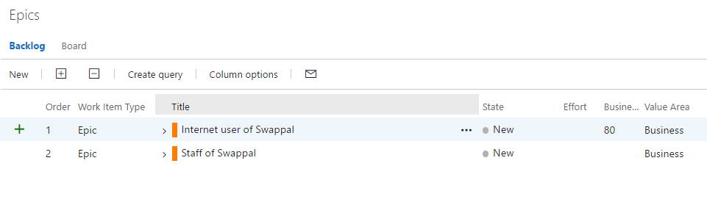
Product backlog-Epics

Slide 61
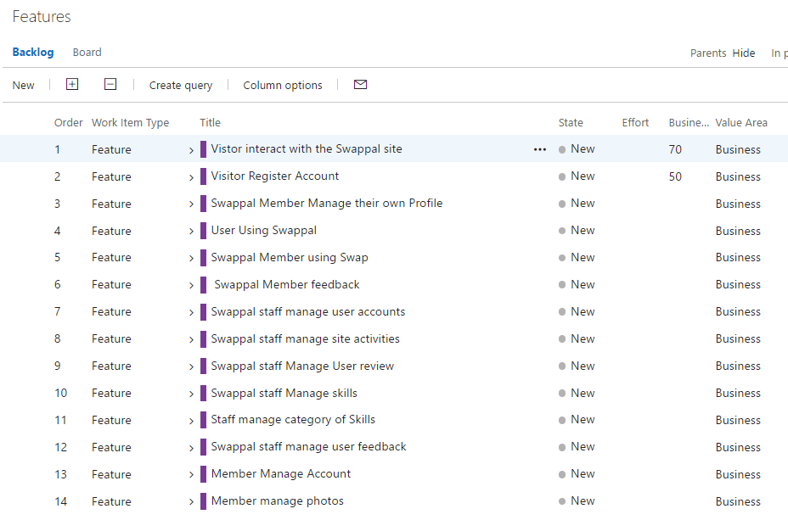
Product backlog-Feature

Slide 62
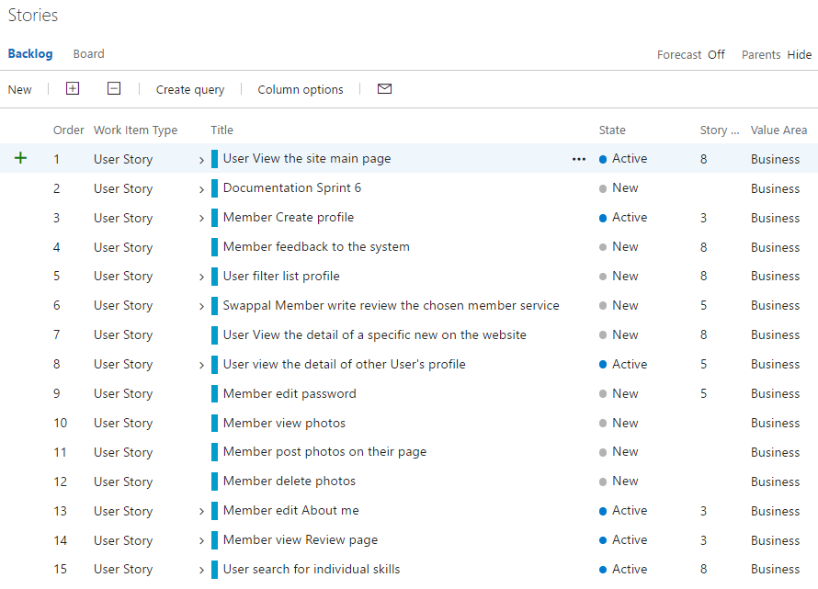
Product backlog-User stories

Slide 63
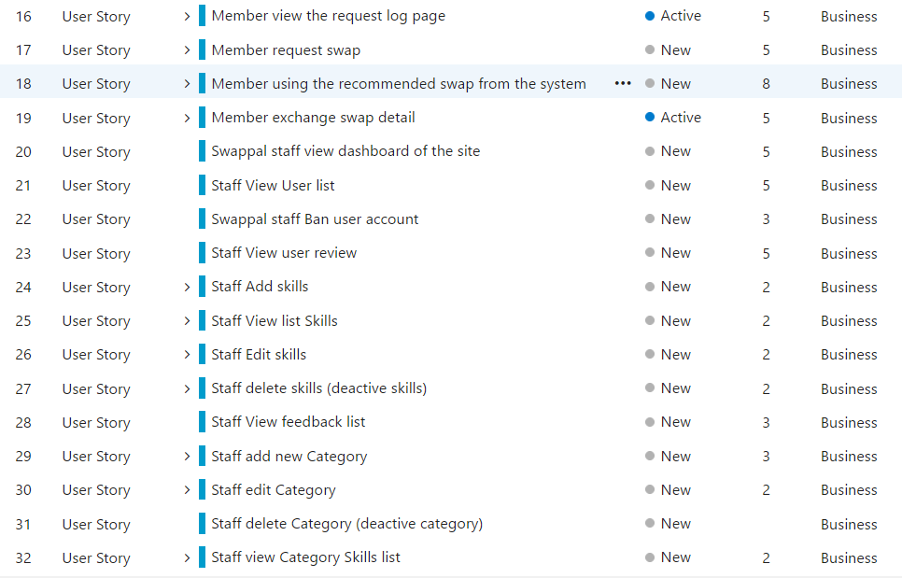
Product backlog-User stories(con’t)

Slide 64
Product development stage
Part 4.0: Design

Slide 65
Design UI

Slide 66
Product development stage
Part 4.0: Design Database schema

Slide 67
Design Database

Slide 68
Project risk

Slide 69
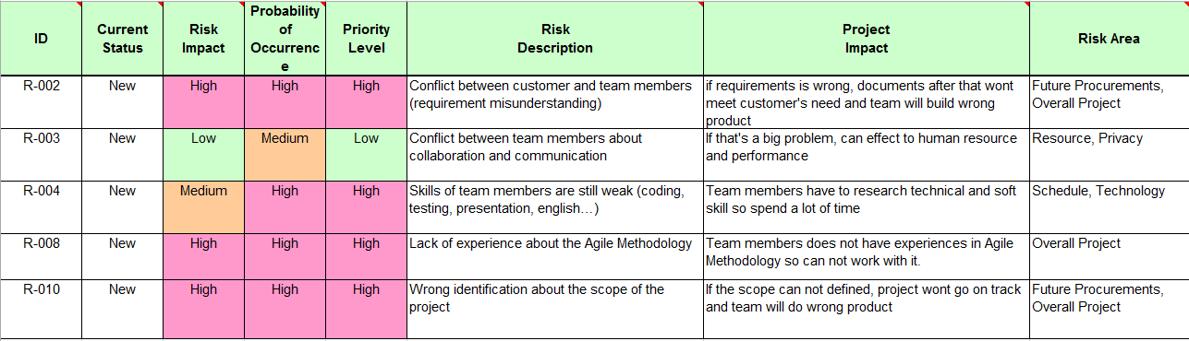
Notes:
Background: Nowadays, lots of people share and get information from each other.
We build community based on sharing new things across the world

Slide 70

Thank you for your attention!
THE END

